Slide 1

Phonics and Early Reading
Welcome to our meeting
Part 1 – information about how we teach phonics
Part 2 – information about how we teach reading

Slide 2

Reading
We want children to
love reading
Learning to read should be
a positive experience
Reading should be
enjoyable
We want children to read
for pleasure
Reading underpins children’s access to the curriculum
and clearly impacts on their achievement
Notes:
We all know how important learning to read is and the impact it has on a childs success - it has to be a positive experience
Whats the reality? Reluctant to read because they find it hard
Frustration stress tears – that’s just the parents
Important to look at the big long term picture

Slide 3

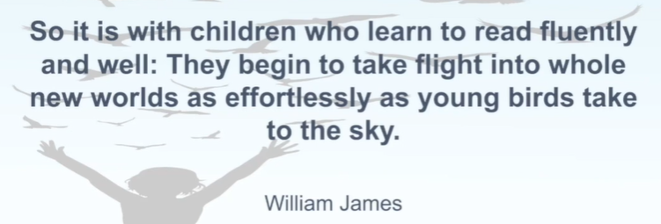
Welcome to Little Wandle!

Slide 4

The journey to independent reading and writing begins with Phonics
littlewandlelettersandsounds.org.uk
Notes:
Government changes mean a change (for the better) in how we teach phonics and reading at school - make sure there is consistency throughout
Early reading is the stage where children are learning to become fluent readers through the use of phonics

Slide 5

Little Wandle
Why change?
New government guidance on Systematic Synthetic Phonics
One scheme approach
Schemes need to be validated
Schemes much provide resources with fully decodable books
Why Little Wandle?
Closest to our current programmes – Letters and Sounds Revised
Research and evidence based
Clear progression and spiral so the children review and revisit regularly
Excellent training for all staff to ensure consistency
Every aspect of phonics and reading included in a detailed, thorough and
systematic approach
Engaging resources without distracting from the learning – great phonically decodable books to support early reading.
Comprehensive system for identifying and supporting children requiring
extra help and useful support for parents.
littlewandlelettersandsounds.org.uk
Notes:
New guidance
Schools that perform best had a single scheme approach (we cherry picked the best bits from several)
Its not about passing a phonics screening – its about accessing the curriculum and wider world through reading.

Slide 6
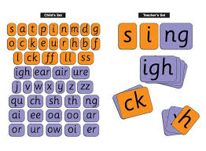
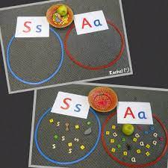
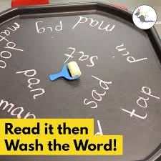
How we teach phonics
Daily short sessions
Specific order of teaching
must
Correct pronunciation
is vital - Videos on LW
https://www.littlewandlelettersandsounds.org.uk/resources/for-parents/
Synthetic phonics
Repeated practice
Revisit previously
taught sounds at
start of each lesson
Practice makes
permanent

Slide 7
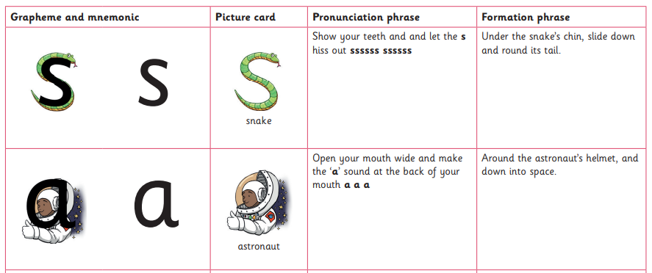
Little Wandle
How does it work?

Slide 8
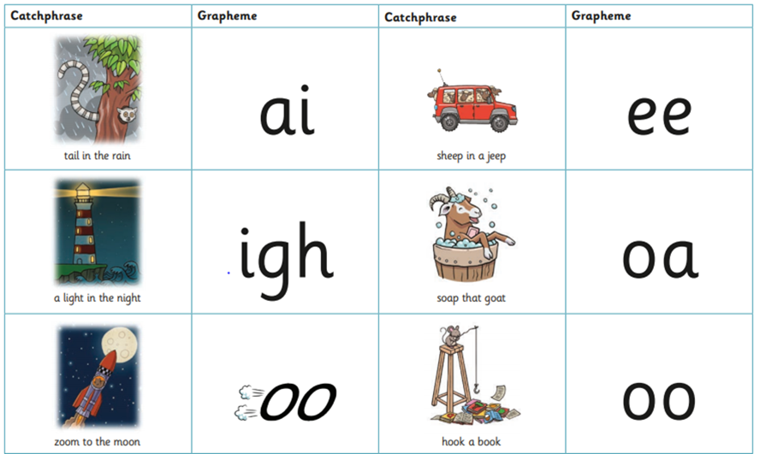
Little Wandle
How does it work?

Slide 9
Little Wandle
the
is
when
How does it work?
Tricky words
Notes:
Phonics it the primary reading strategy so we focus on what they CAN read first and explain why the word is tricky.

Slide 10
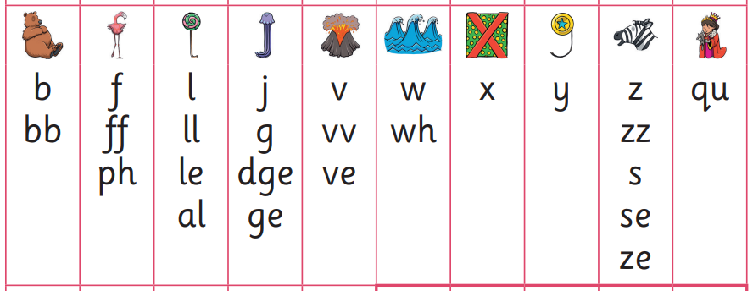
Little Wandle
How does it work?
Grow the code
Notes:
Charts ready to use in class later in the year

Slide 11
Little Wandle
How does it work?
Keep up
- short sharp sessions
- identify children who need extra support early
- same day, same week, after review lesson on Friday
Catch up
- Year 1 children will be doing 2 phonics lessons a day to get them ready for year 1 phonics, learning new digraphs.
- So what does this mean for children who already know these digraphs?
When?
Phonics lessons will take place between 9.10 – 9.30am and 1.00 – 1.20pm.
Notes:
Previously – wait for assessment to then create an intervention plan for the following 5/6weeks
Word lists to support practise at home when a sticker is sent home with a sound on

Slide 12
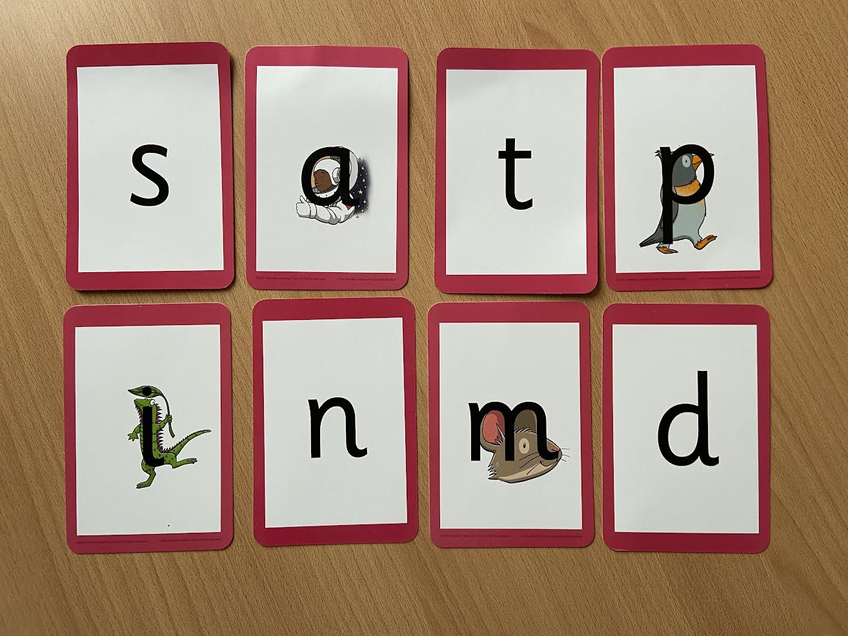
Notes:
Phonemes taught in order start to read words asap
LW has a picture pnemonic to help children remember the phoneme/grapheme

Slide 13
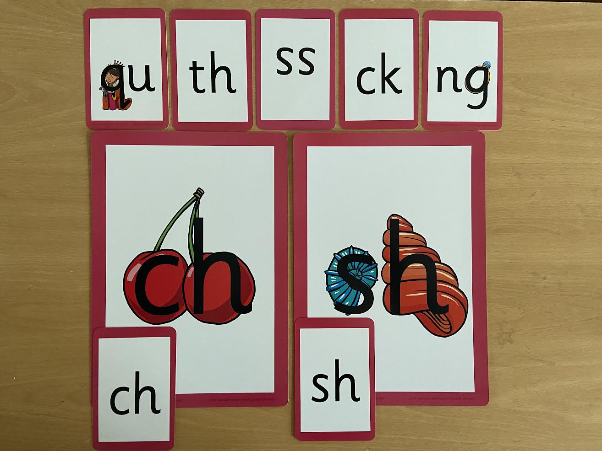
Notes:
Early digraphs mostly consonant digraphs – 2 letters 1 sound

Slide 14
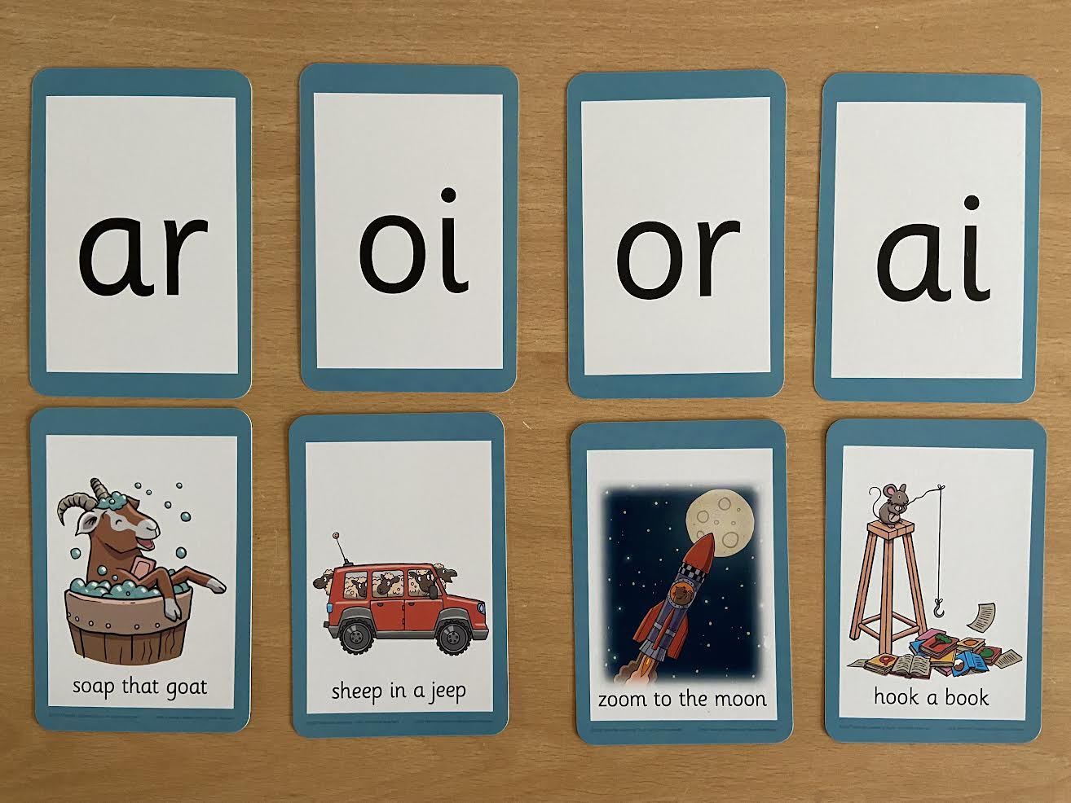
Notes:
Vowel digraphs taught with a short caption to help children remember
Also trigraphs igh, air

Slide 15
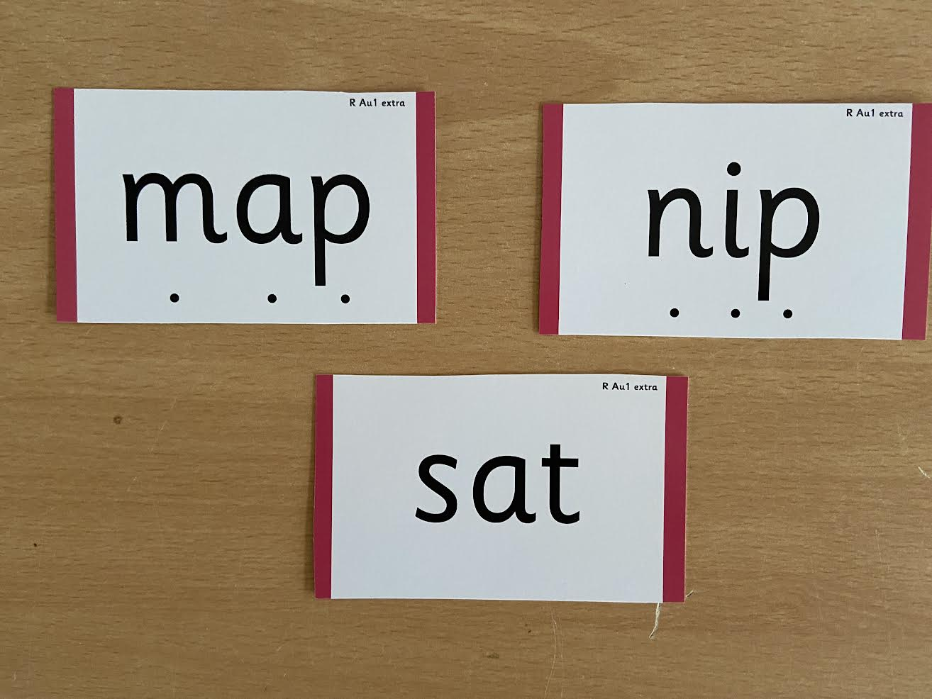
Notes:
During phonics lessons we use Sound buttons so we can sound talk and blend to read

Slide 16
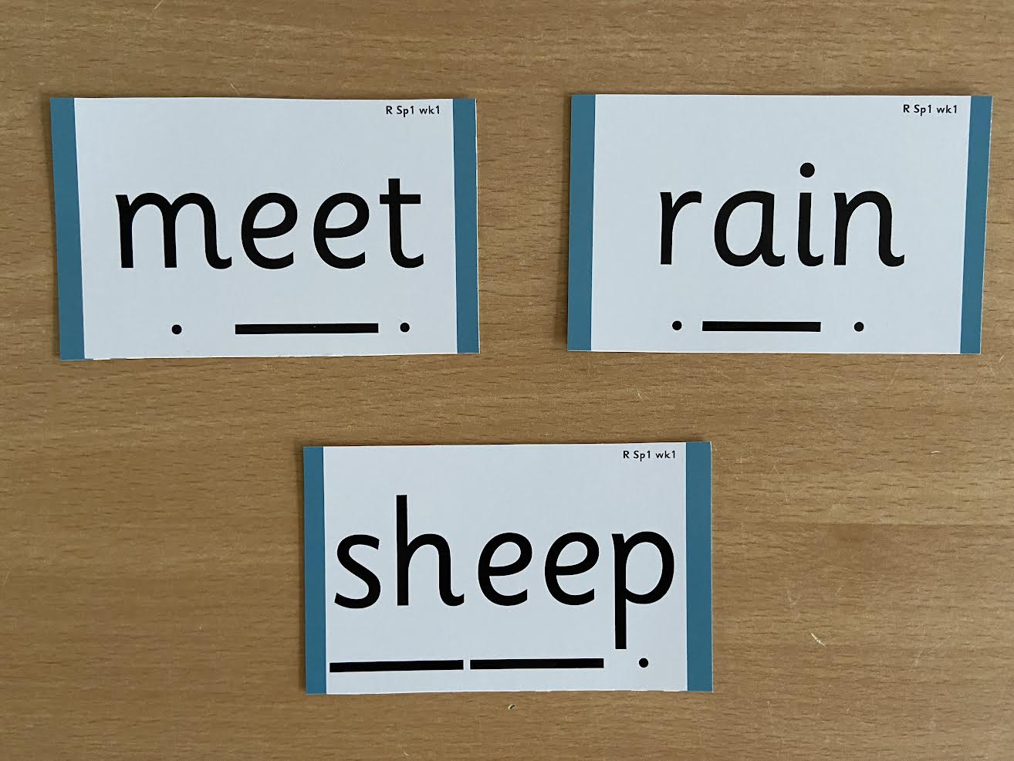
Notes:
Digraphs have a zip to sound talk and blend

Slide 17

Notes:
Words that do not follow the rules and cannot be decoded – tricky words/ exception words
Chn are taught what part of the word is tricky

Slide 18

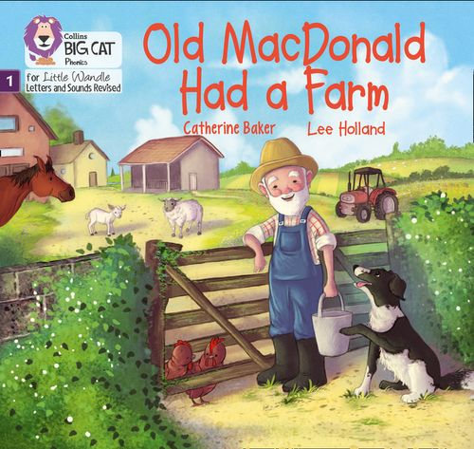

Once children have a secure knowledge of a number of
GPC’s (Grapheme Phoneme Correspondences)
and are confidently blending, they will be ready for
reading books
Prior to this they may have wordless books which develop
great language skills and teach children the layout of books
and how to handle books

Slide 19

How we teach reading
Reading practice sessions are :
Books are :
matched to children’s
secure phonic knowledge
and word reading
Timetabled 3 times a week
Taught by trained teacher or
teaching assistant
read three times
Taught in small groups
sent home – you have access to all the e-books from home
Notes:
Quite a big difference to how reading was previously taught

Slide 20
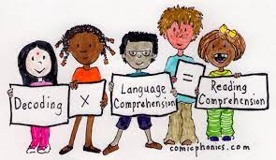
Reading Practice Books carefully matched so children can read fluently and independently
3 Reads – each one begins with some quick sounds and words practice
Day 1 – Decoding
All read the same time
Repeated readings and teacher moves round
Day 2 – Prosody
Reading with meaning, stress and intonation
Choose page to focus on. Repeat after me. Why do we stress certain words? ‘It was a BIG mess’
Day 3 – Comprehension
‘I know the answer because …’
Prove it. Explain it.
When children take their book home to read they should be 95% fluent
Please do not worry that a book is too easy – your child needs to develop
fluency and confidence in reading. Re-reading a book they have had before
helps develop fluency – this is the goal.
Celebrate their success!!!

Slide 21



How will this work?
Children are assessed, then LW matches which books
Should be allocated for their secure phonic knowledge
Children will take their Reading Practice Book home
(after reading it 3 times in school)
Teachers will let you know the days books go home and
when they need to be in school to be changed.
Celebrate, praise, talk about the book with you child.
Please make sure books are in book bags so that
we can reallocate books as required
Please look after our books
Notes:
Children will not be changing book multiple times a week as previously
Reading groups will be set up so you will be notified of when your book will be sent home/ need to be back in school
Groups will change!

Slide 22





Big Cat Collins Reading books are carefully matched to children’s secure phonic knowledge
Notes:
To reiterate - Children will not have books containing GPC’s they have not learned and are not secure with
Look at inside cover

Slide 23





Sharing Book
Children will also bring home a ‘sharing book’ from our class library each week
To become lifelong readers, it is essential that they read for pleasure
Children may not be able to read this book independently but these books offer a wealth of opportunities for talking about the pictures and enjoying the story or information text.
Enjoy the book together and
foster a love of reading
“pair and share”

Slide 24
Little Wandle
Recap
Phonics and English sessions continue as usual.
Regular keep up to support children that found a lesson tricky – look out for stickers on their arm! Ask them what it is and practise that at home.
Interventions for children that are slightly further behind.
Group reading sessions 3 times a week – no more individual readers.
When books come home they have been well practised and you can celebrate their success! Practise leads to fluency!
Website www.littlewandlelettersandsounds.org.uk – for parents

Slide 25
What else can parents do?
Please look at the Little Wandle videos and guidance for parents
Support children in learning the alphabetic code
Let your child “show off” their reading to you and celebrate and praise all the way!
Share books with your children for pleasure
Check on your class page for documents to support reading and phonics

Slide 26
Thank you for joining us.
Any questions?

